Slide 1

B.Tech 7th Semester Major project presentation
“Virtual Migration In Cloud Computing”
Presented by:
Dhruv Pathak-190305105210
Prajesh Prajapati-190305105217 Prof. Umang Panchal
Neel Rathod-190305105230
Supervisors:
PARUL INSTITUTE OF TECHNOLOGY, PARUL UNIVERSITY
NAME OF THE INSTITUTE, PARUL UNIVERSITY

Slide 2
Broad Outline/Background/Problem Statement
In the recent years, the strengths and weakness of the non-traditional IPS for preventing the DOS and DDOS attacks are not explained empirically.
The purpose of this research is to identify the existing Non-Traditional Intrusion Prevention Mechanisms for preventing the DoS attacks and DDoS attacks in cloud computing.
PARUL INSTITUTE OF TECHNOLOGY, PARUL UNIVERSITY
NAME OF THE INSTITUTE, PARUL UNIVERSITY

Slide 3
Introduction
Cloud computing establish number of remote software networks and servers that allow centralized data storage and provides on-demand network access to computing resources.
In cloud computing, Virtual machine migration is a useful tool for migrating Operating System instances across multiple physical machines. It is used for load balancing, fault management, low-level system maintenance and reduce energy consumption.
PARUL INSTITUTE OF TECHNOLOGY, PARUL UNIVERSITY
NAME OF THE INSTITUTE, PARUL UNIVERSITY

Slide 4
Aim and Objectives of Study
To find a quick and efficient way to transfer services between physical servers.
Minimizing downtime.
Keeping total migration time down.
Avoid disrupting active services.
PARUL INSTITUTE OF TECHNOLOGY, PARUL UNIVERSITY
NAME OF THE INSTITUTE, PARUL UNIVERSITY

Slide 5
Novelty/Problem Justification
The defense System classes for DDoS attacks in the cloud are;
  Attack Prevention
  Attack detection
  Attack mitigation
  Recovery
This is all about focusing on the DDoS attack detection and mitigation by emphasizing more on approaches based on count based filtering, resource usage methods, and OS level resource management methods.
PARUL INSTITUTE OF TECHNOLOGY, PARUL UNIVERSITY
NAME OF THE INSTITUTE, PARUL UNIVERSITY

Slide 6
Literature Review
Title | Type Of Source | Summary Points | Limitations
Distributed Denial Of Service Attacks in cloud[1] | Theoratical research (sciencedirect) | Major Ddos incidents, attacks in IOT, categories of Ddos attack, Cloud stimulation related framework. | -the server slows down and service gets disrupted -no standard test bed or platform for IoT security.
Mitigating Distributed Denial Of Service attacks: Network-Defence Methods [2] | Qualitative research (IEEEexplore) | Denial of capability(DOC), Sink tree architecture, | -effectiveness-overhead trade-off by addressing the issue of granularity of control in the network.
Handling System Overload Resulting From DDoS attack[3] | Discussion (IEEEexplore) | Security purpose CAPTCHA - identify human and bot, HTTP predirect module | -Do not have enough resources or infrastructure in place
Migration Based Load Balance of virtual machines[4] | Theoratical research (IEEEexplore) | Large scale management architecture, metaheuristic algorithms, Load balancing mechanism- VMH-GPE- | -migration is a job assignment optimization problem -usually a time consuming
An improved dynamic fault tolerant management algorithm during VM Migration In Cloud data center [5] | Qualitative research (sciencedirect) | DFTM algorithm, Cloud survivability, minimal complexity, recovery mechanisms. | -Poor Reliability -Collateral damage -Under-utilization
PARUL INSTITUTE OF TECHNOLOGY, PARUL UNIVERSITY
NAME OF THE INSTITUTE, PARUL UNIVERSITY

Slide 7
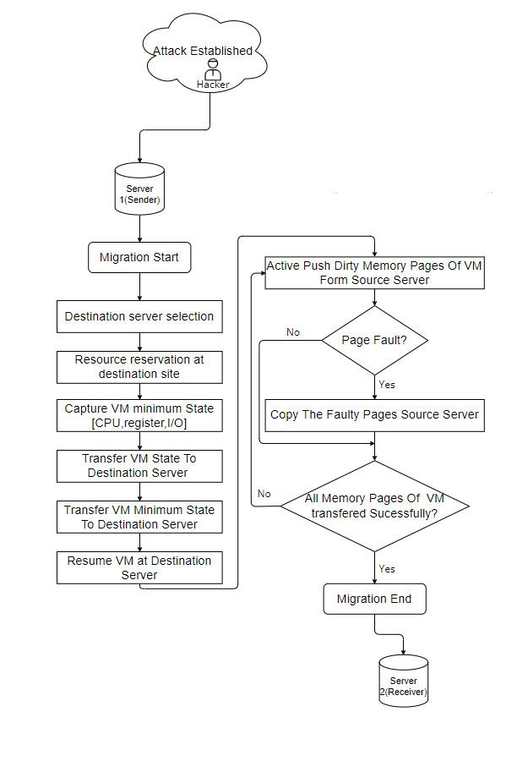
Proposed Methodology
PARUL INSTITUTE OF TECHNOLOGY, PARUL UNIVERSITY
NAME OF THE INSTITUTE, PARUL UNIVERSITY

Slide 8
Work Plan/Time line
 | June | July | Aug |  | Sep | Oct | Nov | Dec
Getting topic information of the topic
Presentation of thesis proposal (Review 1)
Collecting data and study the past previous research papers
Presentation for Mid-Sem (Review 2)
Research of the algorithms and methods
Data Analysis
Implementation of the new algorithm
Report writing
Presentation of thesis
PARUL INSTITUTE OF TECHNOLOGY, PARUL UNIVERSITY
NAME OF THE INSTITUTE, PARUL UNIVERSITY

Slide 9
GUI And Approx. Budget
Not Applicable…
PARUL INSTITUTE OF TECHNOLOGY, PARUL UNIVERSITY
NAME OF THE INSTITUTE, PARUL UNIVERSITY

Slide 10
Future Scope
As a future enhancement, there can be an approach which minimizes the trade-off between energy consumption and good performance (QoS).
This can be done by using a hybrid technique which uses a combination of server consolidation for energy-efficiency as well as it performs load balancing to deliver better quality of service.
This is a two-staged process comprising—firstly, ‘Green computing’ for maximum resource utilization.
Secondly ‘Overload-Avoidance’ can be performed for load balancing. The overloading can be avoided by continuously keeping a check on the ‘Hot Threshold’.
Greening of data centers by implementing the above suggested hybrid technique.
PARUL INSTITUTE OF TECHNOLOGY, PARUL UNIVERSITY
NAME OF THE INSTITUTE, PARUL UNIVERSITY

Slide 11
Prons & Cons
Pros:
Extremely Scalable:- can be migrated smoothly among servers for the performance parameters, load balancing, and energy saving.
VM migration is utilized for effective workload movement which has very small service downtime.
Cons:
To migrate VM’s between private and public cloud as well as different service providers. There is currently no provision for live migration in or out of a public cloud environment.
While performing software updates, fixing out some hardware problems, and recovery from unexpected issues.
PARUL INSTITUTE OF TECHNOLOGY, PARUL UNIVERSITY
NAME OF THE INSTITUTE, PARUL UNIVERSITY

Slide 12
Conclusion
An analysis of the various technique and algorithms under virtual migration reveals that there exist many challenges with respect to the techniques which are used to minimize the down time and total migration time in order to provide better performance in limited bandwidth.
In future, we are going to implement algorithm or technique that choose VM to migrate and explore a group of host to identify the place where possibly VM can be stored that will improve the overall performance of migration.
PARUL INSTITUTE OF TECHNOLOGY, PARUL UNIVERSITY
NAME OF THE INSTITUTE, PARUL UNIVERSITY

Slide 13
References
https://www.sciencedirect.com/science/article/abs/pii/S1574013720304329
https://ieeexplore.ieee.org/document/6377740
https://ieeexplore.ieee.org/document/7371531
https://ieeexplore.ieee.org/document/9374470
https://www.sciencedirect.com/science/article/abs/pii/S0167739X18324208
PARUL INSTITUTE OF TECHNOLOGY, PARUL UNIVERSITY
NAME OF THE INSTITUTE, PARUL UNIVERSITY

